Slide 1
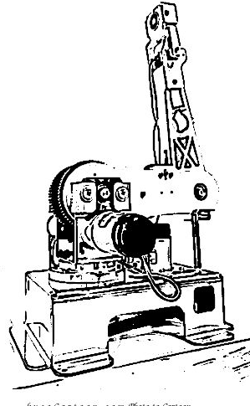
Project Competition
Advisor: 葉廷仁 教授
TAs: 董祐華 林容緣 張弘豫 陳仕昕
Date: 2024/05/22

Slide 2
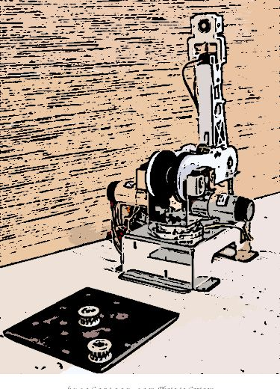
Outline
Schedule
Simulation Contest
Real Arm Contest
Appendix

Slide 3
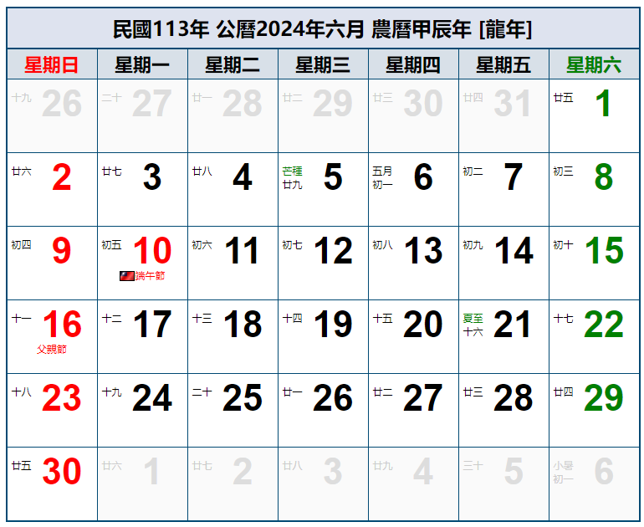
1. Schedule
Simulation
Competition
In R402
期末考週
Real Arm
Competition
In R402

Slide 4
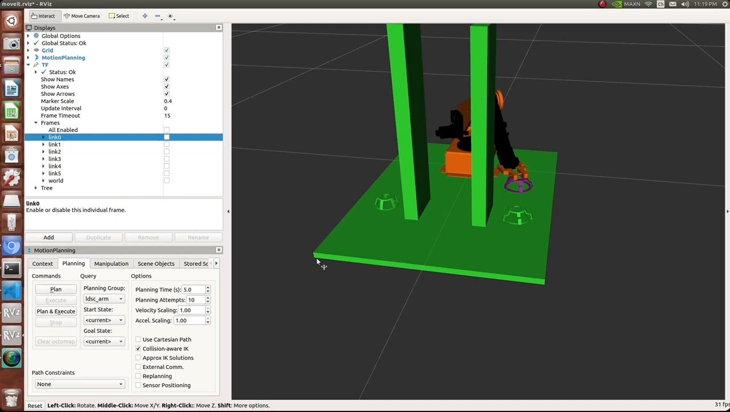
2. Simulation Contest
競賽內容:
6/12(三) 上課時間，會在R402進行模擬競賽，內容如下兩頁影片所示，先在Rviz中生成河內塔與障礙物，整合Lab4的IK程式讓手臂端末到達指定的位置與姿態，並抓起河內塔(變紫色)放到指定位置，重複直到堆疊完成。

Slide 5

2. Simulation Contest
影片1---無障礙物
https://www.youtube.com/watch?v=jG8LxCkJqKE

Slide 6
2. Simulation Contest
影片2---有障礙物
https://www.youtube.com/watch?v=x0SRCvkXIbY

Slide 7
2. Simulation Contest
競賽規則:
規則1: (起始,最終)河內塔的位置，在各組出場前由助教隨機決定
A
B
C
A
B
C
7 steps
規則2: 怕萬一實體競賽沒分數，有個備案，才舉行模擬競賽，不計分。必須加入障礙物，形狀可自由發揮。

Slide 8
2. Simulation Contest
Setup
Download the mesh folder (from elearn) into /catkin_ws/src/myplan
Download the 0_hanoi_planner.py and 0_hanoi_spawn_objects.py files into /myplan/src
Tutorial of how to spawn Hanoi towers in Rviz
>>roslaunch myplan 0_demo.launch
>>rosrun myplan 0_hanoi_spawn_objects.py

Slide 9
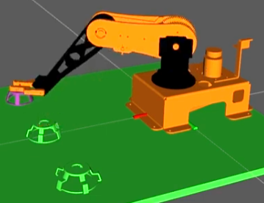
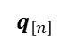
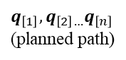
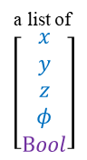
2. Simulation Contest
Flow Chart
a list of
$$\left[\begin{aligned}\begin{matrix}x \\ y \\ z \\ φ\end{matrix} \\ Bool\end{aligned}\right]$$
IK
Lab4_code()
$$q_{\left[n\right]}$$
Spawn objects
add_box()
add_mesh()
Hanoi
your_code()
MoveIt
path-planning
go_to_joint_state()
obstacle-avoidance
Magnet on/off
attach_mesh()
detach_mesh()
$$q_{\left[1\right]},q_{\left[2\right]…}q_{\left[n\right]}$$
(planned path)
Modify the sample code(/myplan/src/0_hanoi_planner.py)
You should add some parts of 0_hanoi_spawn_objects.py into 0_hanoi_planner.py.
9

Slide 10
2. Simulation Contest
Implementation:
(1) >>roslaunch myplan 0_demo.launch
(2) >>rosrun myplan 0_hanoi_planner.py

Slide 11
3. Real Arm Contest
競賽內容:
6/19(三) 上課時間，會在R402舉行實體競賽，內容如下頁影片所示，並加上障礙物。各組手臂鎖在自己的木板上比賽，出場順序當場抽籤。

Slide 12
3. Real Arm Contest
Demo
https://youtu.be/qwChLCVZasA?si=9at6OJDTt-mp8WjW&t=5191

Slide 13
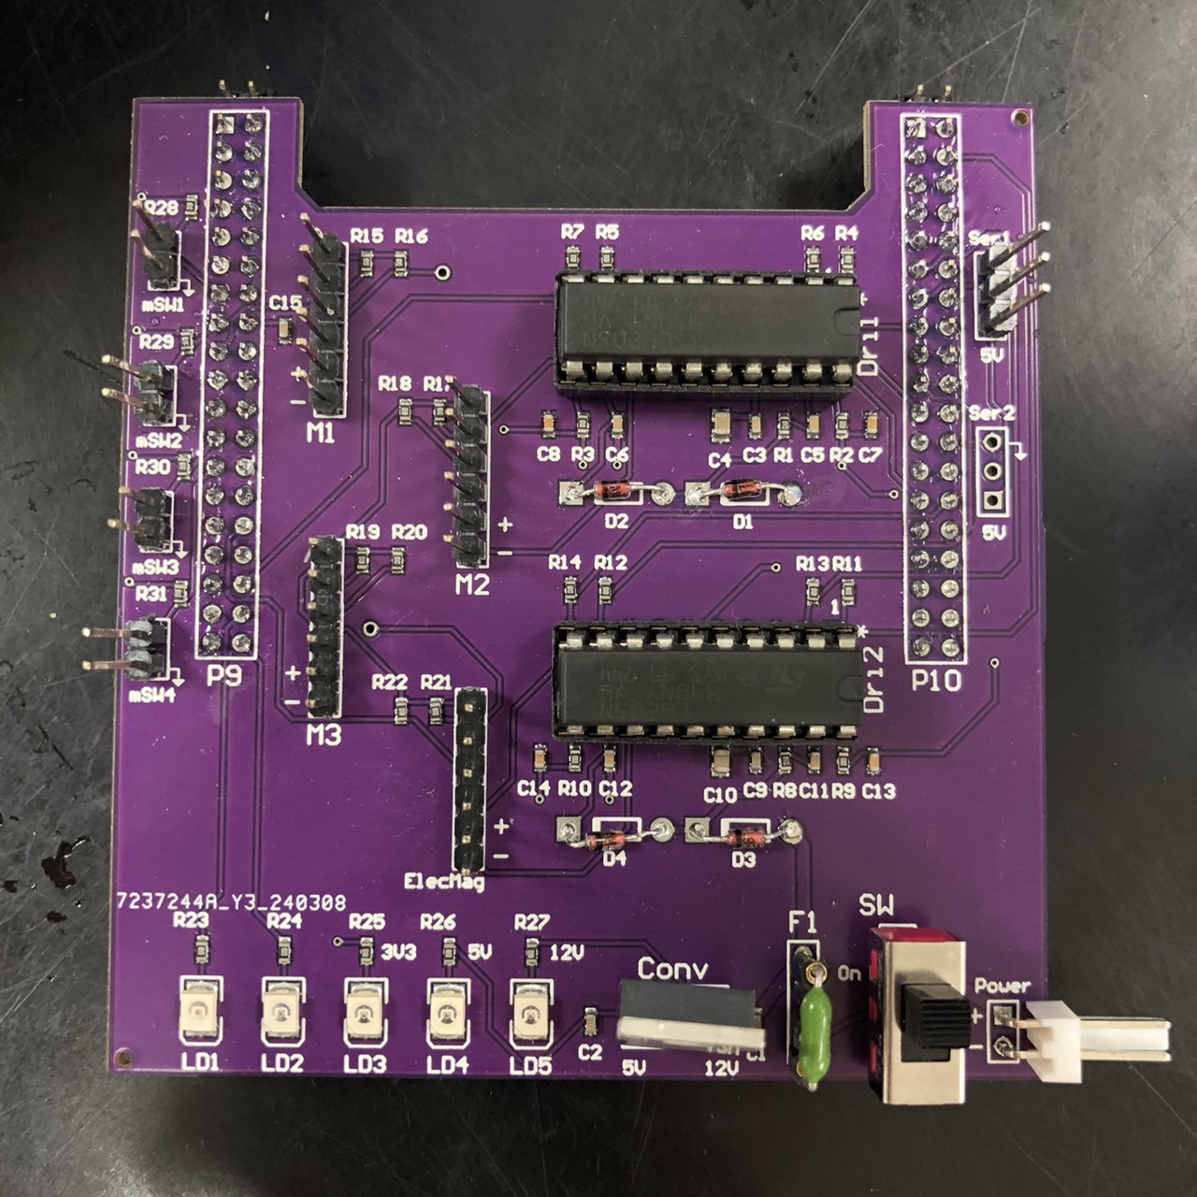
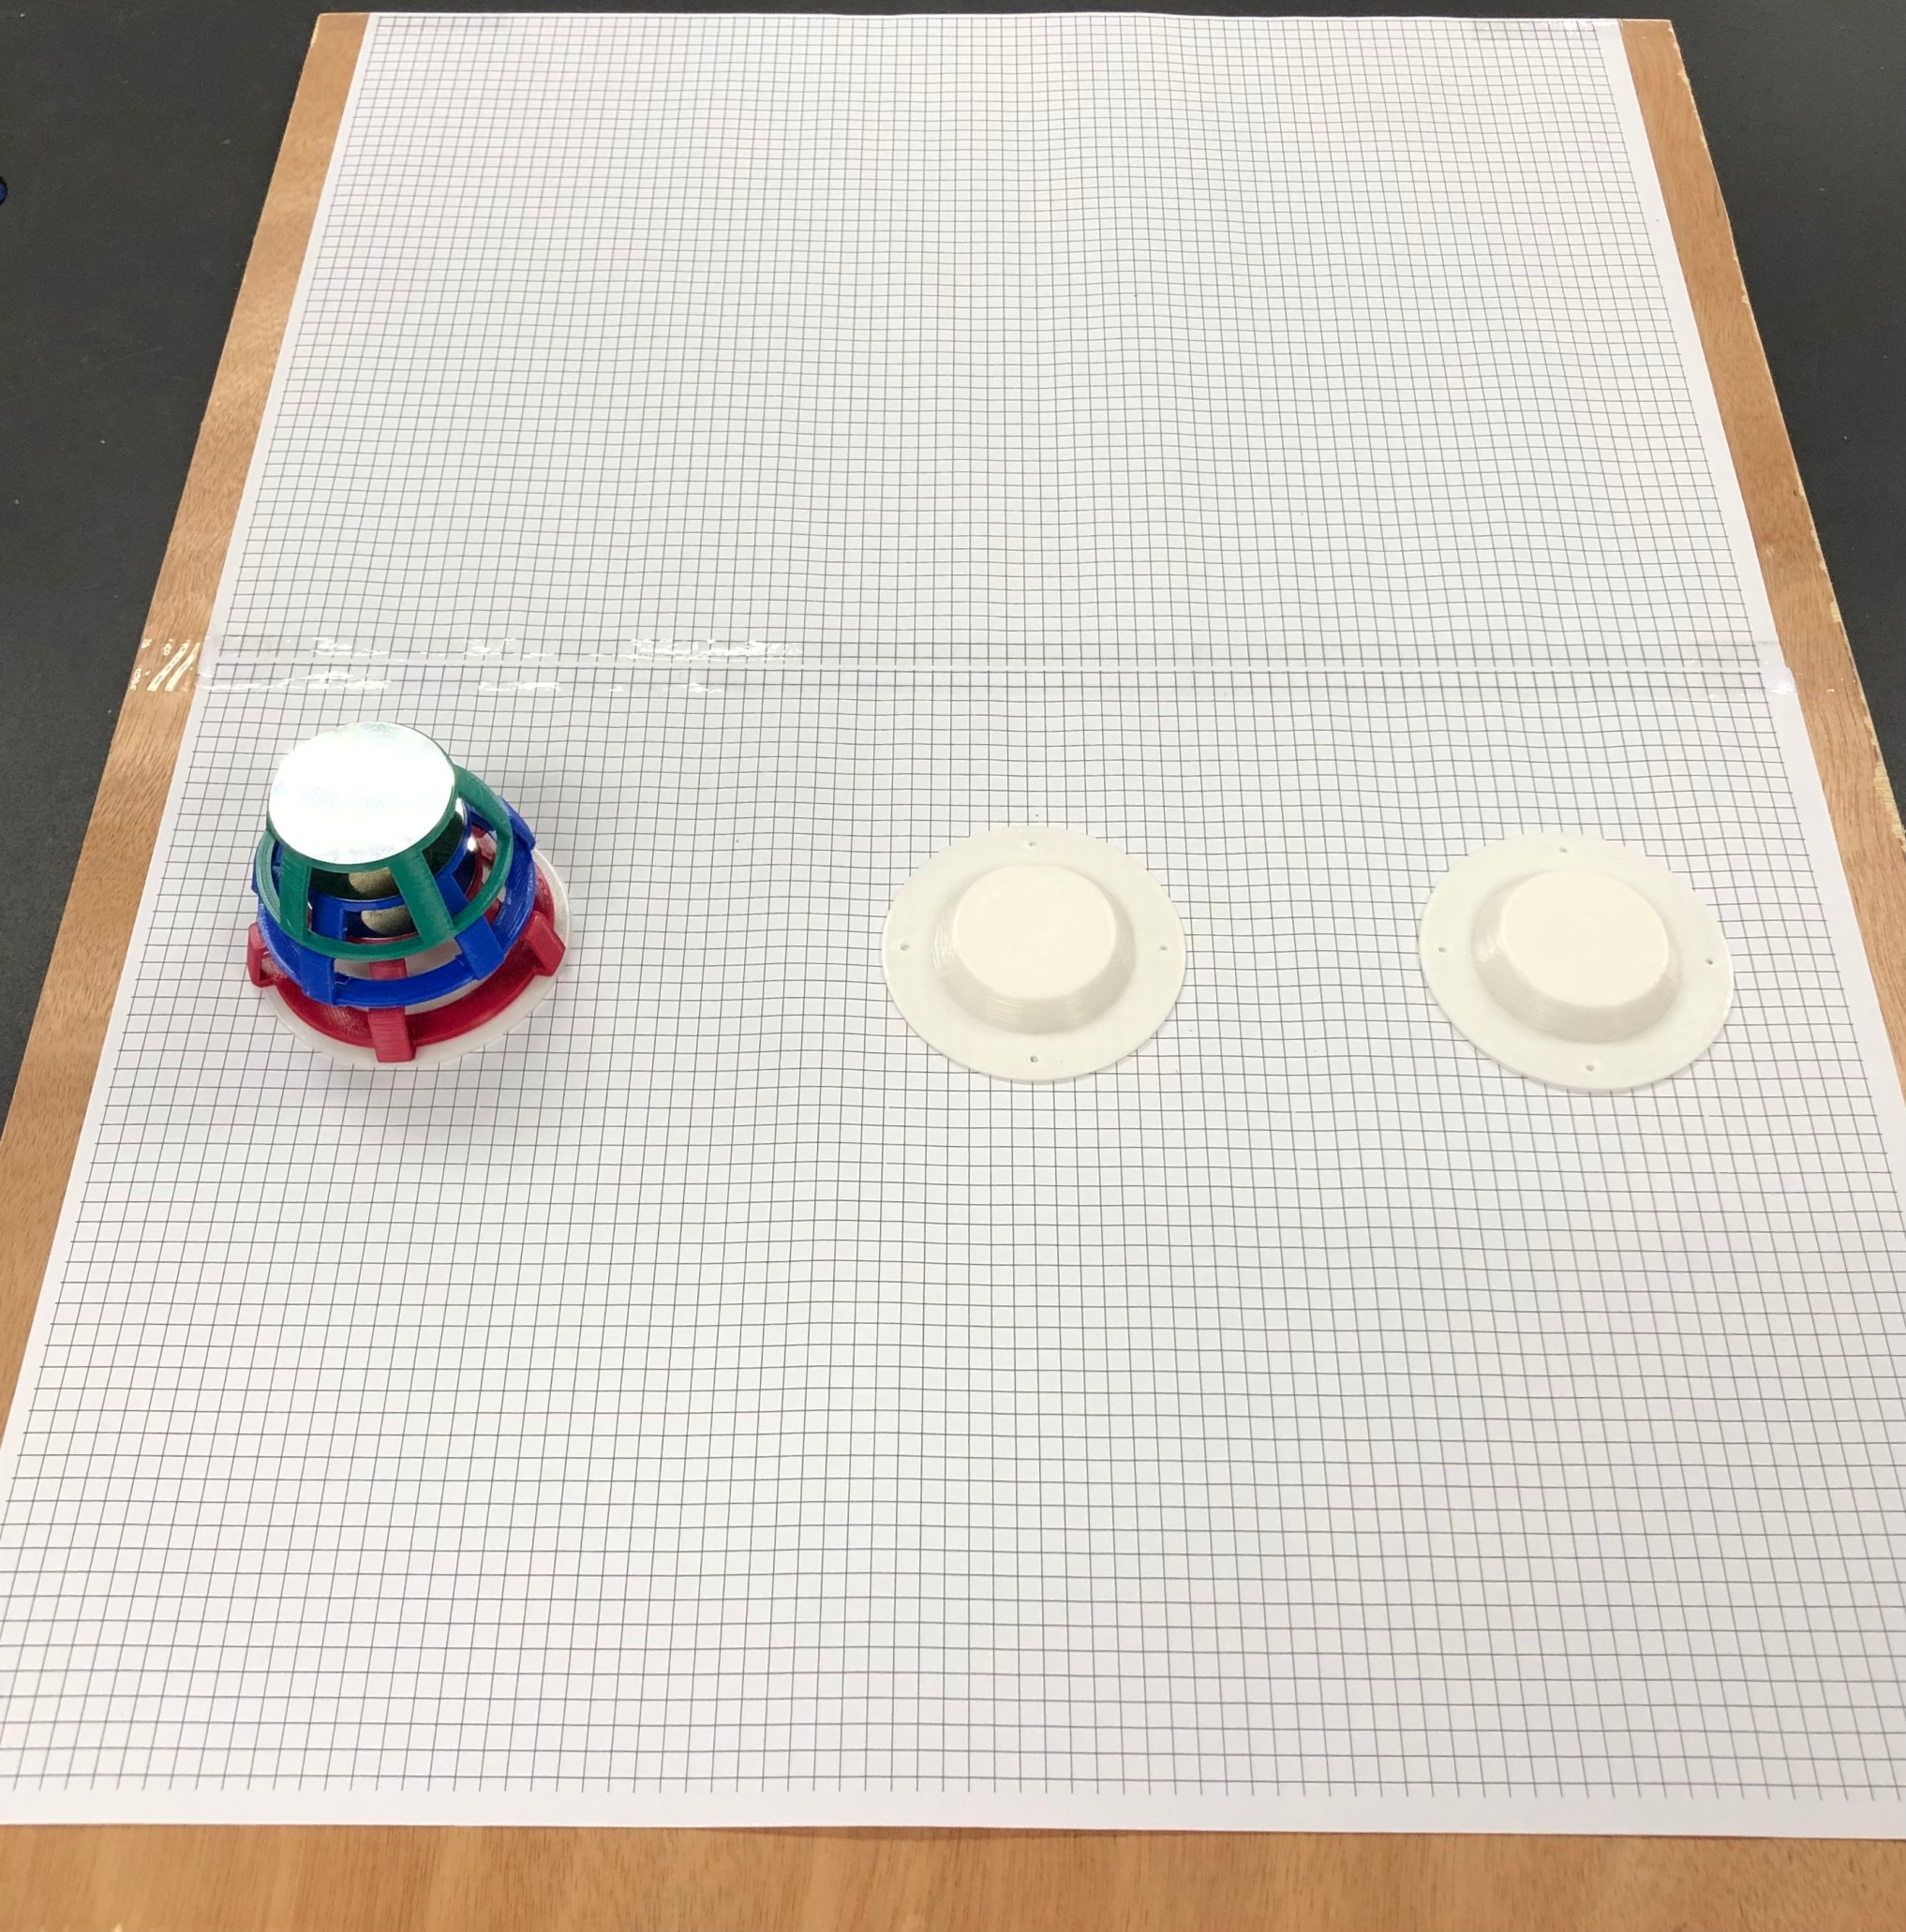
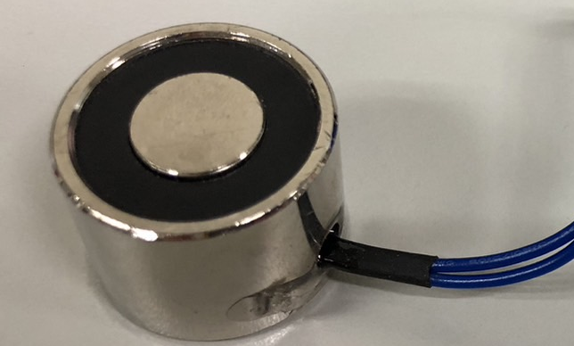
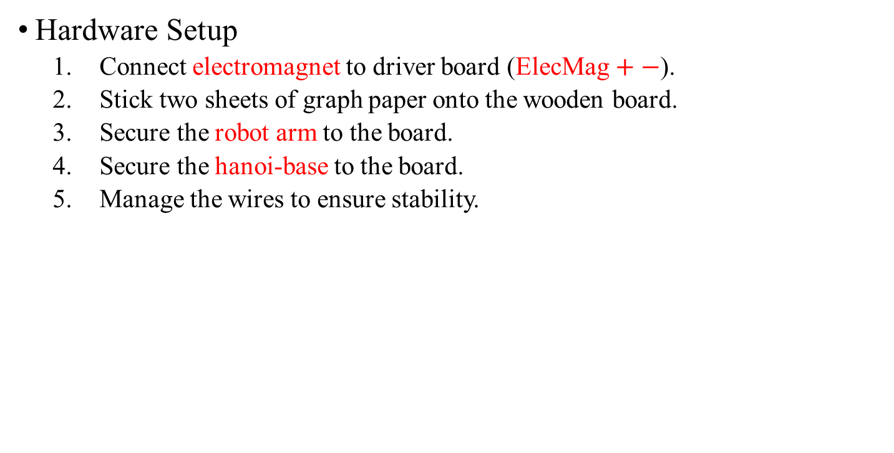
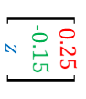
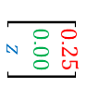
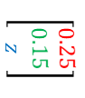
3. Real Arm Contest
Hardware Setup
Connect electromagnet to driver board (ElecMag $+−$).
Stick two sheets of graph paper onto the wooden board.
Secure the robot arm to the board.
Secure the hanoi-base to the board.
Manage the wires to ensure stability.
$$\left[\begin{matrix}0.25 \\ 0.15 \\ z\end{matrix}\right]$$
Robot
Arm
$$\left[\begin{matrix}0.25 \\ 0.00 \\ z\end{matrix}\right]$$
$$\left[\begin{matrix}0.25 \\ −0.15 \\ z\end{matrix}\right]$$

Slide 14
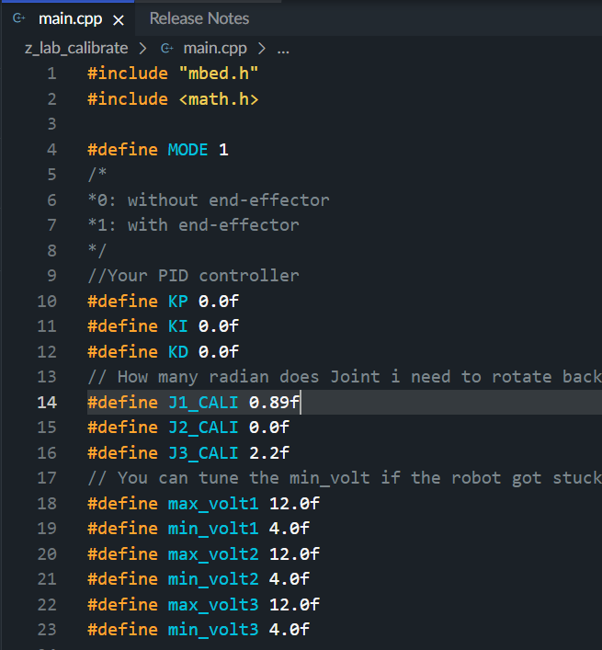
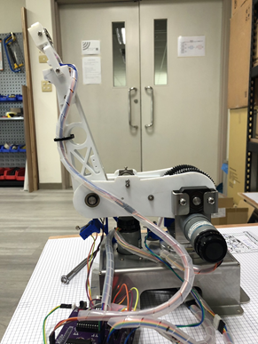
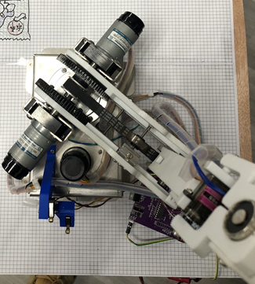
3. Real Arm Contest
Firmware Setup
Download new “Robotics_ST” from elearn and paste into main.cpp
Modify the parameters.
開啟電磁鐵功能
J3_CALI
微調校正角度
J1_CALI

Slide 15
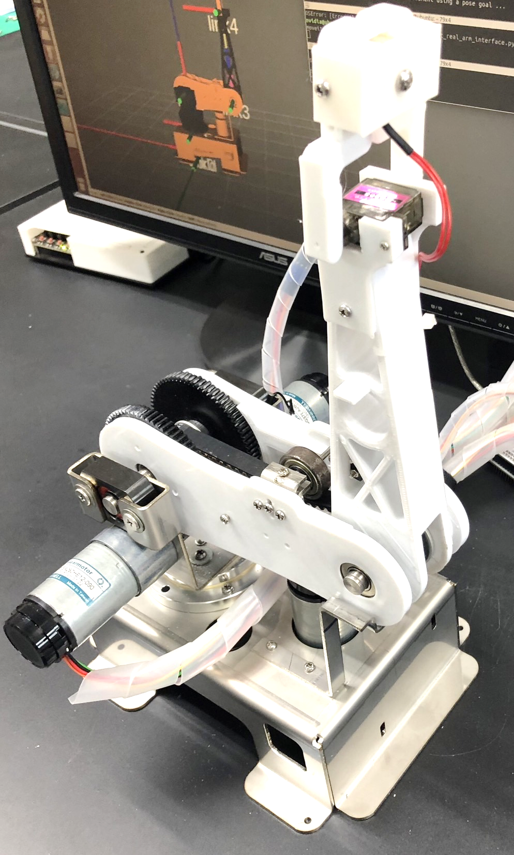
3. Real Arm Contest
Firmware Setup
Download 0_magnet_moveit_real_arm_interface.py into /myrobot_control/src
Download 0_magnet _serial_with_ST.py into /myrobot_control/src
Modify your_keyboard_control in Lab3 to confirm every part works well.
Original (Lab3):
Joint_angle.data = [pi/2, 0, -pi/2, 0]
New (Lab5):
Joint_angle.data = [pi/2, 0, -pi/2, 0, eef_state]
yourKeyboardControl.py
yourKeyboardControl.cpp
0_magnet_serial_with_ST.py
/real_robot_arm_joint
(Float64MultiArray)

Slide 16
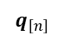
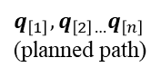
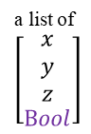
3. Real Arm Contest
Flow Chart
a list of
$$\left[\begin{aligned}\begin{matrix}x \\ y \\ z\end{matrix} \\ Bool\end{aligned}\right]$$
MoveIt
path-planning
go_to_joint_state()
obstacle-avoidance
IK
Lab4_code()
$$q_{\left[n\right]}$$
Spawn objects
add_box()
add_mesh()
Hanoi
your_code()
$$q_{\left[1\right]},q_{\left[2\right]…}q_{\left[n\right]}$$
(planned path)
Magnet on/off
pub_EefState_to_arm()
/SetEndEffector
(Bool)
0_magnet_moveit_real_
arm_interface.py
Combine the sample code
(/myplan/src/0_hanoi_planner.py)
(/myplan/src/0_hanoi_spawn_objects.py)
0_magnet_serial_with_ST.py

Slide 17
3. Real Arm Contest
Implementation :
(1) Make sure the real robot in Home Position(as graph).
Calibrate first (hold blue and click black)
(2) >>roslaunch myplan 0_demo.launch
(3) >> rosrun myrobot_control 0_magnet_moveit_real_arm_interface.py
(4) >> rosrun myrobot_control 0_magnet_serial_with_ST.py
(5) Set up power supply, 12V parallel 3A 3A
(Keep a finger on the power button)
(6) >>rosrun myplan 0_hanoi_planner.py
Home Position

Slide 18
To be released…
模擬競賽詳細規則與細節(如: 時間表)
實體競賽詳細規則與細節(如: 晉級規定、障礙物形狀等)

Slide 19
舊競賽規則參考
競賽規則:
規則1: (起始,最終)河內塔的位置，會在各組出場前由助教抽籤決定
A
B
C
A
B
C
7 steps
這個範例中，起始河內塔在A位置，最終要搬到B位置，縮寫成(A,B)

Slide 20
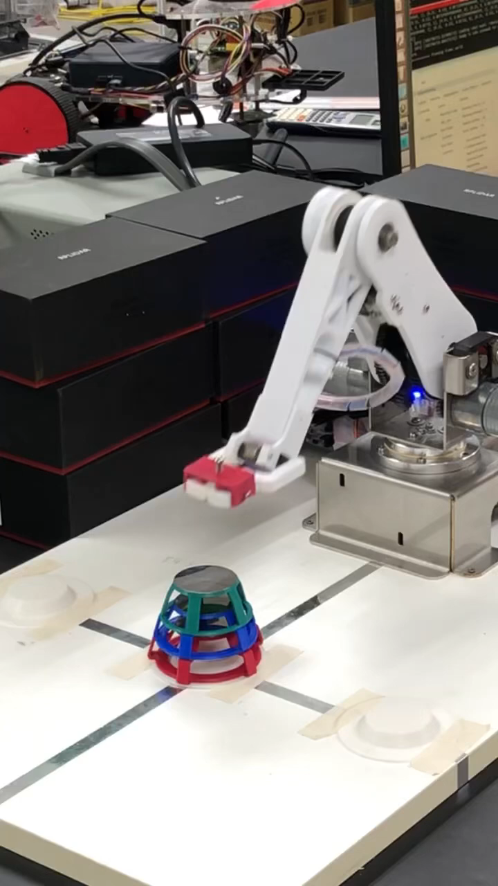
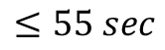
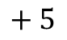
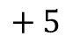
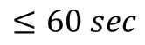
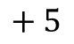
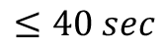
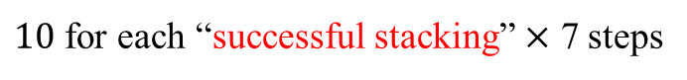
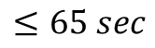
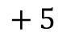
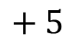
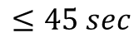
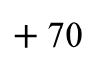
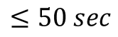
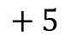
舊競賽規則參考
競賽規則:
規則2:計分方式
Mission Completed:
$+$70
$10$ for each “successful stacking” $×$ 7 steps
(You can rescue the tower from falling down instantly,
but the 10 points will be taken off.)
$$≤65 sec$$
$$+ 5$$
$$≤60 sec$$
$$+ 5$$
$$≤55 sec$$
$$+ 5$$
$$≤50 sec$$
$$+ 5$$
$$≤45 sec$$
$$+ 5$$
$$≤40 sec$$
$$+ 5$$
To goal within 45 secs, some extra works should be done.

Slide 21
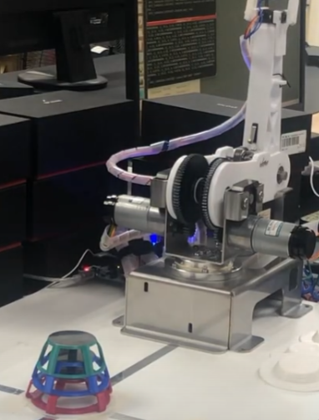
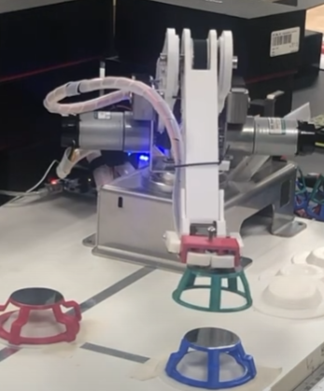
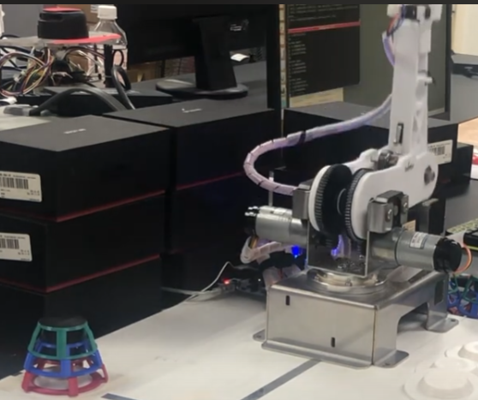
舊競賽規則參考
競賽規則:
規則3:計時方式
Leave the home position
(Time start)
Stack the towers
Mission complete
and
go back to home position
(Time runs)
(Time stop)

Slide 22
舊競賽規則參考
競賽規則:
規則4: 若兩組分數相同，耗時較少者勝出。

Slide 23
舊賽程表參考
賽程表如下頁，以下為文字說明:
各組會被分到A(4組), B(3組), C(3組)進行第一輪競賽
ABC組內，積分最高者，直接晉級最後一輪
A組(第二三名)、BC組(第二名)進行四搶一復賽
ABC組內，積分最後者……淘汰QQ
最後一輪，從4組中取冠軍、亞軍、季軍

Slide 24
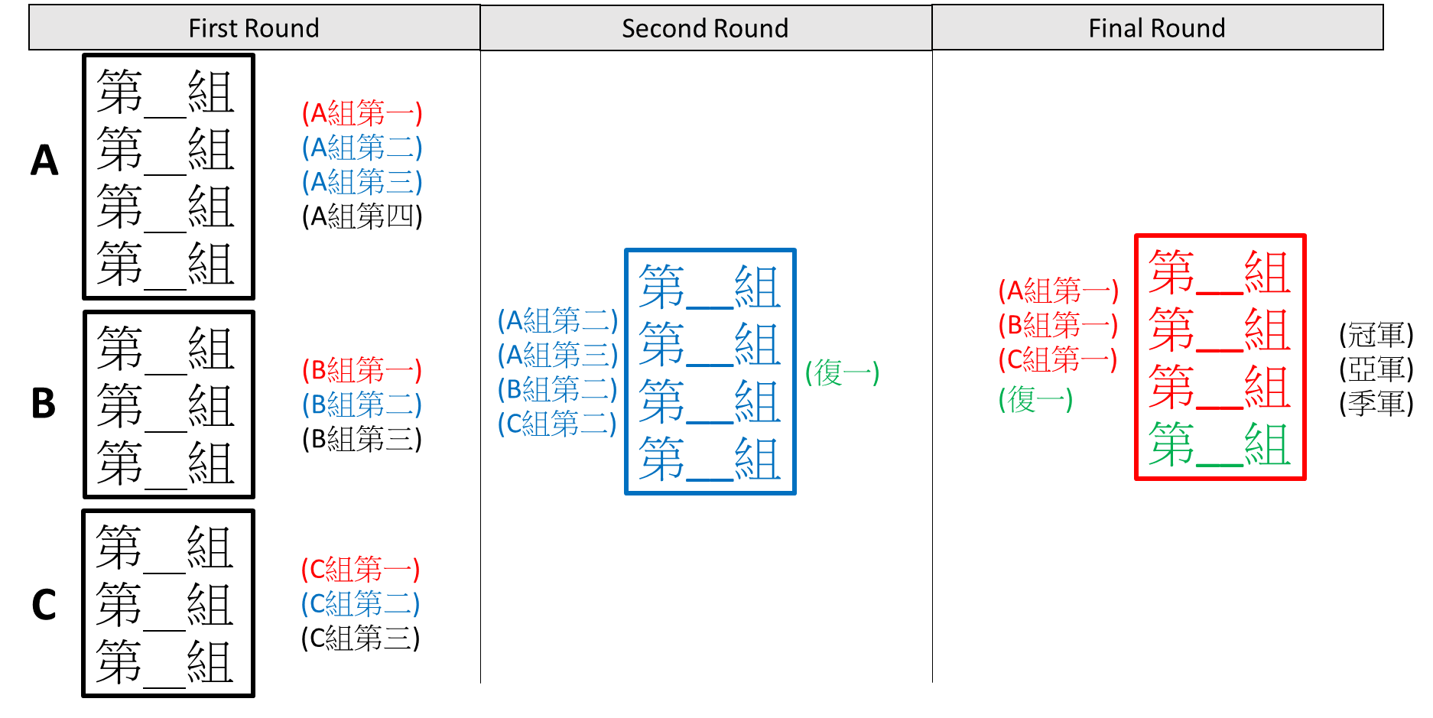
舊賽程表參考

Slide 25
4. Appendix
Some issues:
由於TX2(CPU)算力較不足，且實驗河內塔的形狀不規則，在模擬環境做碰撞偵測、閉障、路徑規劃要算很久。若無法升級硬體，實體手臂競賽時，可以考慮把規畫好的路徑存取出來。
Sample code內有河內塔幾何參數，若不清楚可直接到R402量測

